Slide 1
A
Week 9
The ABC Pattern
B
C

Slide 2
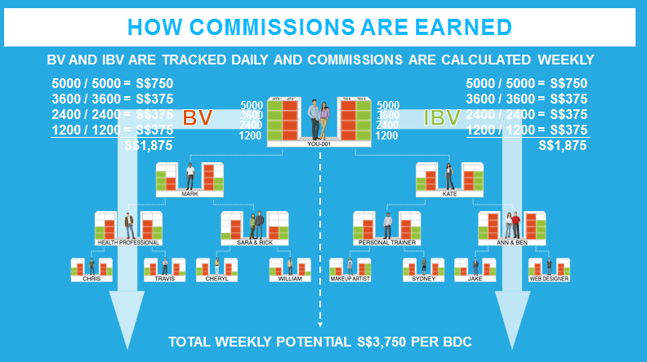
Build a TEAM
Together
Everyone
Achieve
More

Slide 3
Duplication and the ABC Pattern
The objective for new UnFranchise® Owners is to lead the prospects while demonstrating the best practices to build the business and create duplication

Slide 4
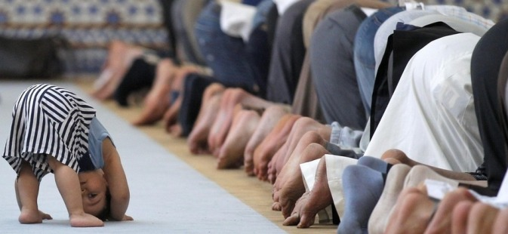
Monkey See Monkey Do

Slide 5
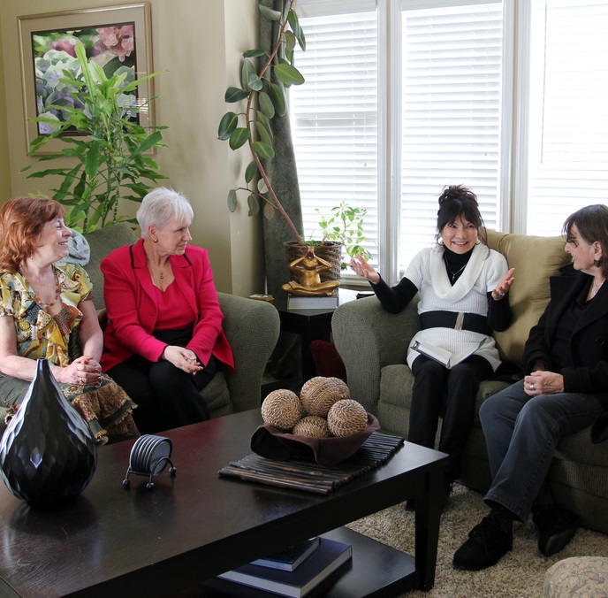
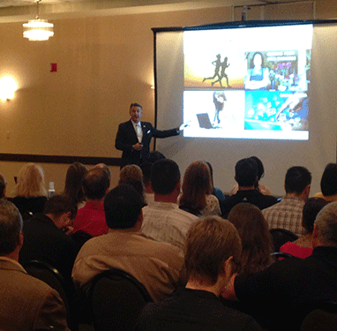
The ABC Pattern
1 on 1, 2 on 1, or webinar
HBP Home Business
Presentation
UBP UnFranchise® Business Presentation
One on One
Two on One
Online Presentation Webinar/Skype

Slide 6
Meeting after
the Meeting
Sponsor
Book
Follow-up
Provide
more info
1
2
You
Use
Products
Bring to UBP
3
4
Sell Tickets
Cashback on SHOP.COM
5
6
SHOP.COM tour
Referrals – who do you know?
A
A
7
8
Assist in calls
9

Slide 7
3 Form of ABC Pattern
#1: Trial Run method building from home to home
#2: Leadership training in depth
#3: Type of leadership to train.

Slide 8
#1 Key Success Factors of the ABC Pattern
When doing the ABC Pattern you can let someone sign up at any point once they have lead to people that are interested in the business.
The key to the ABC pattern is to always book a follow up and a meeting in the next new person’s house/location.
Answer questions/provide more information
Show the Plan (to them and/or people they believe have an interest)
Get Started

Slide 9
#1 Trial Run Method
SPONSOR
YOU
A
A
B
B
C
C
A1
A1
B1
B1
C1
C1

Slide 10
# 2ABC PATTERN OF DUPLICATION
Assist Go Now Independent Distributors through their first 3 levels of duplication – they should then be able to take over as a leader

Slide 11
#2 ABC Pattern of Duplication & Building Depth
SENIOR PARTNER
YOU
A
A
B
B
C
C
A1
A1
B1
B1
C1
C1
A, B, C, etc. are Go NOW Distributors

Slide 12
HBP 2:1 or HBP
A
Sponsor B
B
Sponsor C
C
Sponsor A1
A1
Sponsor B1
B1
Sponsor C1
YOU A
A
You
A
You
2.Intro
3.Product
4.Plan
5.Closing
A
You
4.Plan
5.Closing
A
You
A
You
A
You
5.Closing
6.Guidance
Who’s Next
B
B
6.Guidance
5.Closing
B
1.Welcome
HI, My Name is B. Welcome to my house
B
4.Plan
B
2.Intro
3.Product
C
4.Plan
C
5.Closing
C
2.Intro
3.Product
C
1.Welcome
HI, My Name is C. Welcome to my house
A1
2.Intro
3.Product
A1
4.Plan
A1
B1
2.Intro
3.Product
1.Welcome
B1
1.Welcome
C1
1.Welcome

Slide 13
Product Event: Wellness, TLS, Beauty
A
Sponsor B
B
Sponsor C
C
Sponsor A1
A1
Sponsor B1
B1
Sponsor C1
YOU A
A
You
A
You
2.Intro
3.Ice Breaker
4.Video
5. Review Survey
6.Closing
A
You
4.Video
5.Survey Review
6.Closing
A
You
A
You
A
You
6.Closing
7.Guidance
Who’s Next
B
B
7.Guidance
6.Closing
B
5. Survey Review
B
2.Intro
3.Ice Breaker
C
5. Survey Review
C
6.Closing
B
1.Welcome
HI, My Name is B. Welcome to my house
2.Intro
3.Ice Breaker
4. Video
C
C
1.Welcome
HI, My Name is C. Welcome to my house
A1
2.Intro
3.Ice Breaker
4. Video
A1
5. Survey Review
2.Intro
3.Ice Breaker
4. Video
A1
B1
1.Welcome
B1
1.Welcome
C1
1.Welcome

Slide 14
#3 ABC Role
A Advisor
Typically an established or growing leader that is mastering the B5. Have the Right Posture, skill and experience to help facilitate a appointment closure.
B Bridge
A up and coming leader but still on working on learning the B5. B will prepare all the literature, tools to facilitate the closure.
C New UFO or Prospect
Brand New Distributor who wants to learn the B5

Slide 15
THE ABC PATTERN GIVES YOU…
SUCCESS
GROWTH
PROGRESS
TIMING
IT TAKES THE CHANCE OUT OF IT!
CONTROL
OVER YOUR

Slide 16
#3 ABC
Goal is to have more A Advisor in your team
Residual Income = BV + Leaders aka Advisor

Slide 17
# ABC pattern
A - Advisor
B - Bridge
C - Customer or Prospect

Slide 18
Why ABC Pattern
Leverage A’s experience and knowledge
Learning process
Leverage A posture and experience to close

Slide 19
Be a qualified B
Before meeting
Build up rapport with C
Promote A
Create a business atmosphere by choosing appropriate time and location
Prepare follow up materials
Set up following up appointment with A

Slide 20
Be a qualified B
During meeting
On time
Dress properly
Take notes
No interruptions, save all the questions to the end

Slide 21
Be a qualified B
After meeting
Document your recruiting journal.
Follow up in 48 hours
Next

Slide 22
Working Combinations
The ultimate leverage
Work multiple legs per night in local geographic area
Recruit, train and retain all at the same time
Builds momentum

Slide 23
COMBINATIONS
Must Be Activated To Work Combinations
YOU
002
003
Karen
Thomas
Tampa, FL
Sarasota, FL
Home Business Presentation
Home Business Presentation
Bring New Person to Follow - Up
Feb 29
March 15
Bring New Person to Follow - Up
Outcome: You are working two organizations in one night!

Slide 24
GMTSS Events
YOU
Also Allow You
To Work
002
003
Combinations
PLUS GUESTS
PLUS GUESTS
Karen
Thomas
Tampa, FL
Sarasota, FL
LOCAL SEMINAR
LOCAL SEMINAR
PLUS GUESTS
PLUS GUESTS
PLUS GUESTS
Largo, FL
PLUS GUESTS
UNFRANCHISE BUSINESS PRESENTATIONS
UNFRANCHISE BUSINESS PRESENTATIONS
DISTRICT CONFERENCES
DISTRICT CONFERENCES
REGIONAL CONVENTIONS
REGIONAL CONVENTIONS

Slide 25
COMBINATIONS
YOU
002
003
PS
PS
PS
NEW
NEW PROSPECT
TO FOLLOW
-
UP
Follow
Ups
BRING NEW PERSON TO FOLLOW
-
UP
Home Business Presentation
BRING NEW DISTRIBUTORS
FOLLOW PS
PS
April 10

Slide 26
CROSS-POLLINATION STRATEGY
Start by Doing It In Your Region

Slide 27
CROSS-POLLINATION STRATEGY
YOU 001
YOU 002
YOU
003
NJ
NJ
New Jersey
Delaware
Maryland
Pennsylvania
DE
DE
MD
MD
PA
PA

Slide 28
CROSS-POLLINATION STRATEGY
Then Expand Nationwide

Slide 29
“ma University”
CROSS-POLLINATION STRATEGY
YOU 001
YOU 002
YOU
003
Motives®
Motives
Web Sites
Motives
Web Sites
Transitions
nutraMetrix
Web Sites
Transitions™
Transitions
nutraMetrix®
nutraMetrix

Slide 30
The ABC Business Pattern
Remember, it never unfolds perfectly, it will duplicate through GO NOWS who are seeking to master the B5
After each meeting schedule another meeting (HBP, product preview, webinar) to invite prospects to
Always book the next appointment (follow up)

Slide 31
Stumbling Blocks in the Business
Not personally prospecting and personally sponsoring
Not selling ticket to new Independent Distributors
Not listening to audios
Not building repeat customer base
Not showing the plan
Waiting for an UnFranchise® Business Presentation
Not plugging into a B5, NDT or Specialized Trainings
Spending too much time with Stable & Waiting Independent Distributors
Not using the Getting Started Guide
No follow up, lack of scheduling/planning (lack of discipline)

Slide 32
The ABC Pattern
It duplicates through “GO NOWS” who are seeking to master the B5.
Teach everyone to master Follow-Up and ABC Pattern of Building Depth.
After each meeting, schedule next step.
Make sure the people you are holding the meeting for GONOW WITH YOU.
Remember, it never unfolds perfectly.

Slide 33
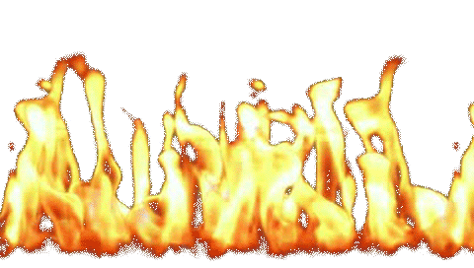
DUPLICATION COMES FROM THE
BOTTOM UP, NOT THE TOP DOWN
Light the fire in the basement not the attic!

Slide 34
THE ABC PATTERN GIVES YOU
Control Over Your
Success
Growth
Progress
Timing
It takes the chance out of it

Slide 35
Ongoing Steps to Success
Use and share the products
Maintain a minimum 10 customers ordering at least 30 BV and 20 IBV per month
Show the business plan twice each week
Continue to work in the homes (ABC Pattern)
Personally sponsor two new business partners per quarter
Achieve Master UFO program quarterly

Slide 36
Ongoing Steps to Success
Attend a minimum of one training per month (B5, NUOT, ECCT, specialized trainings, Local, District, Regional)
Attend the Market America | SHOP.COM International Convention and World Conference annually
Duplicate success by buying and selling tickets to your current and new team members (and prospects)
As your business grows continue to communicate and work with your team

Slide 37
Lead by example.
You must succeed so
other people can
realize their dreams.
-JR Ridinger

